Slide 1
Secure data hiding in images using steganography
CAPSTONE PROJECT
Presented By: SURAPTO SINHA
Student Name : SURAPTO SINHA
College Name & Department : DR D Y PATIL VIDYAPEETH PUNE

Slide 2
OUTLINE
Problem Statement
Technology used
Wow factor
End users
Result
Conclusion
Git-hub Link
Future scope

Slide 3
Problem Statement
In today's digital age, the secure transmission of sensitive information (e.g., personal data, confidential messages, or cryptographic keys) over public networks is a critical challenge. Traditional encryption methods, while effective, often draw attention to the fact that sensitive data is being transmitted, making them a target for malicious actors. To address this, there is a need for a more covert method of data transmission that can hide information in plain sight without raising suspicion.

Slide 4
Technology used
Platform:
Python (Programming language): Programming language to write code.
Visual Studio Code: Environment to develop the project.
Libraries:
OpenCV: To process images.
OS: To configure file paths.
Tkinter: For adding a Graphical User Interface (GUI).

Slide 5
Wow factors
Enhanced Data Security: Steganography adds an extra layer of security by hiding the existence of sensitive information, making it less likely to be targeted by attackers.
Covert Communication: Steganography allows information to be transmitted secretly without drawing attention, which is critical in scenarios where privacy is paramount.
Protection Against Cyber Threats: By hiding data within innocuous files (e.g., images, audio, or video), steganography reduces the risk of interception or tampering during transmission.
Resistance to Detection: Unlike encryption, which makes it obvious that data is being protected, steganography conceals the very existence of the data, making it harder for adversaries to detect.

Slide 6
End users
Journalists: Sharing leaked documents or confidential reports with hidden data in images or audio files.
Military and Defence Organizations: Transmitting classified information securely between personnel or agencies.
Intelligence Agencies: Covert communication and surveillance.
Healthcare Organizations: Securely transmitting patient data and medical records.
Artists and Photographers: Digital watermarking to protect intellectual property.

Slide 7
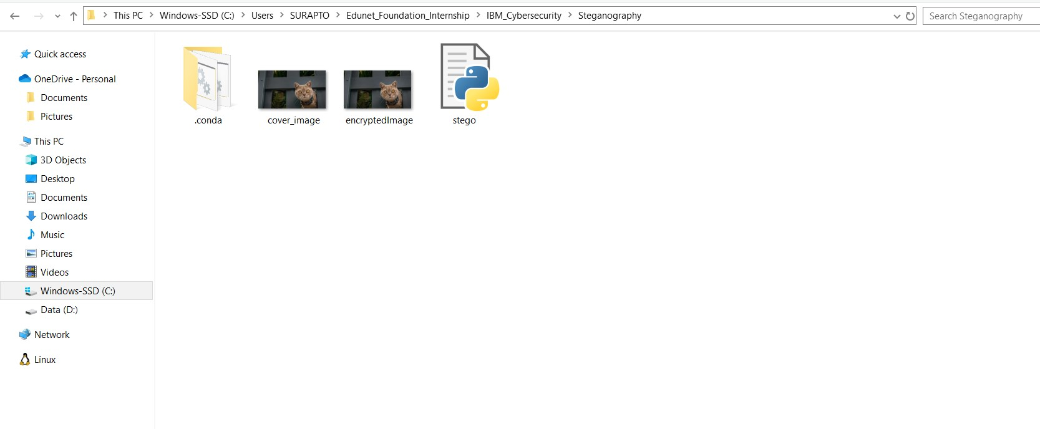
Results

Slide 8
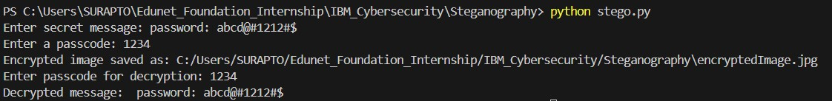
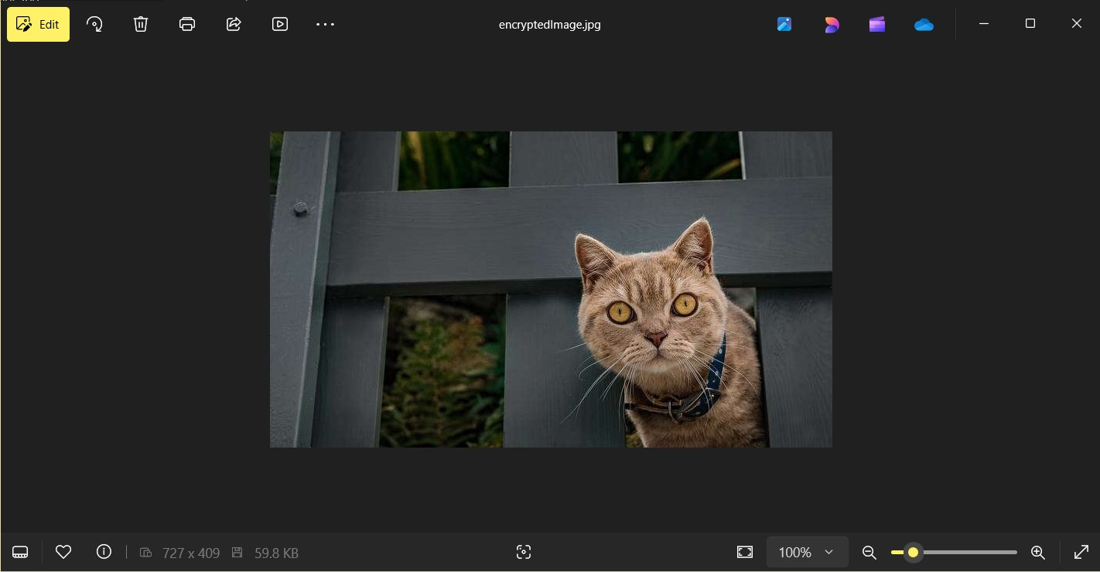
Results

Slide 9
Conclusion
This project successfully demonstrates the development and implementation of a robust steganographic system designed to address the challenges of secure data transmission in the digital age. By combining steganography with encryption, the project achieves a high level of security, ensuring that sensitive information remains hidden and protected from unauthorized access.

Slide 10
GitHub Link
https://github.com/sinhasurapto/IBM_Cybersecurity_Steganography.git

Slide 11
Future scope(optional)
Advanced Steganographic Algorithms: Explore and implement more sophisticated steganographic techniques, such as wavelet-based methods, deep learning-based steganography, or adaptive steganography.
Real-Time Data Hiding: Develop real-time steganography for video and audio streams, enabling live data hiding during communication.
Cross-Platform Compatibility: Create mobile and web-based versions of the system to make it accessible on multiple platforms (e.g., Android, iOS, web browsers).

Slide 12
THANK YOU

